Slide 1
FREE
PPT TEMPLATES
INSERT THE TITLE
OF YOUR PRESENTATIO HERE

Slide 2
Two Key Terms
Remembrance
Memorial
A retained mental impression; memory.
Something that serves to bring to mind or keep in mind some place, person, event, etc.;
something designed to preserve the memory of a person, event, etc., as a monument or a holiday

Slide 4
“1” Lord
1 Cor 8:6 “⁶ yet for us there is one God, the Father, of whom are all things, and we for Him; and one Lord Jesus Christ, through whom are all things, and through whom we live.”
Jn 13:13 “¹³ You call Me Teacher and Lord, and you say well, for so I am.
Eph 4:5 “⁵ one Lord, one faith, one baptism;”

Slide 5
“1” Lord
1 jn 2:2 “² And He Himself is the propitiation for our sins, and not for ours only but also for the whole world.”
1 Jn 4:10 “¹⁰ In this is love, not that we loved God, but that He loved us and sent His Son to be the propitiation for our sins.”
"He is the propitiation for our sins." The Greek word hilasmos can be translated as "propitiation," "expiation," or "atonement."
All of these refer to settling, satisfying, or repaying a debt. In other words, Jesus is the one and only sufficient payment for the sins of humanity.
Without this payment, we are left separated from God.
Notes:
Only one man offered His life on Calvary for our sins

Slide 6
“2” Thieves
Mt 27:38 “³⁸ Then two robbers were crucified with Him, one on the right and another on the left.”
Mark 15:27-28 “²⁷ With Him they also crucified two robbers, one on His right and the other on His left. ²⁸ So the Scripture was fulfilled which says, “And He was numbered with the transgressors.”
1 Pet 2:21-23 “²¹ For to this you were called, because Christ also suffered for us, leaving us an example, that you should follow His steps:
²² “Who committed no sin, Nor was deceit found in His mouth”;
²³ who, when He was reviled, did not revile in return; when He suffered, He did not threaten, but committed Himself to Him who judges righteously;

Slide 7
“2” Thieves
Represent all of mankind
Initially both reviled against Him (Mt 27:44)
One thief changed (Lk 23:39-42)
One thief repentant
One thief unrepentant
All of mankind falls into one of these two categories

Slide 8
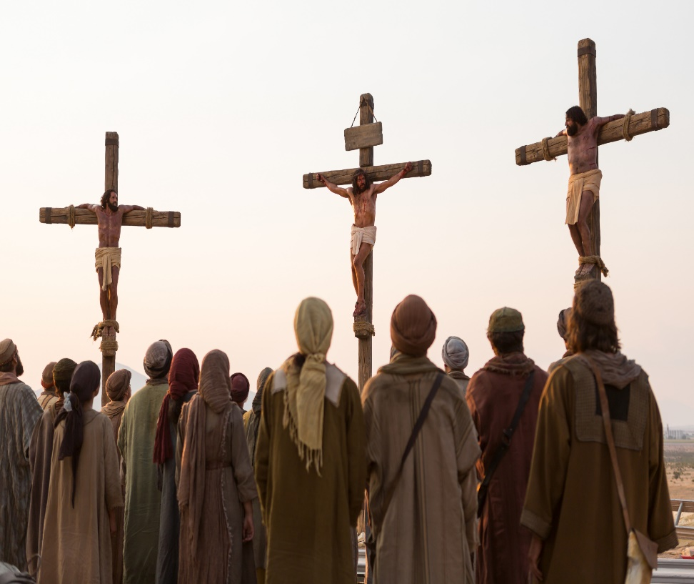
“3” Crosses
One of rebellion and unrepentance (Lk 23:39)
One of sorrow and repentance (Lk 23:40-43)
One of redemption
(1 Pet 2:24; 1 Tim 2:6)

Slide 9
“4” Parts of His Garments
Jn 19:23-24 “²³ Then the soldiers, when they had crucified Jesus, took His garments and made four parts, to each soldier a part, and also the tunic. Now the tunic was without seam, woven from the top in one piece. ²⁴ They said therefore among themselves, “Let us not tear it, but cast lots for it, whose it shall be,” that the Scripture might be fulfilled which says:
“They divided My garments among them, And for My clothing they cast lots.”
Therefore the soldiers did these things.
Individuals who were crucified were stripped of all their dignity…their last remaining possessions were taken from them and given to those who would make sure the death sentence was carried out
May we never forget the humiliation Christ experienced on that day for the sins we have committed

Slide 10
“5” Wounds (piercings)
Ps 22:16 “¹⁶ For dogs have surrounded Me; The congregation of the wicked has enclosed Me. They pierced My hands and My feet;
Jn 19:34 “³⁴ But one of the soldiers pierced His side with a spear, and immediately blood and water came out.”
Nails pierced His hands and His feet (4)
A spear pierced His side (1)
Is 53:5 “⁵ But He was wounded for our transgressions, He was bruised for our iniquities; The chastisement for our peace was upon Him, And by His stripes we are healed.

Slide 11
“6” Hours
Mk 15:25 “²⁵ Now it was the third hour, and they crucified Him.”

Slide 12
“6” Hours (hrs 3-6)
Mk 15:25-28 “²⁵ Now it was the third hour, and they crucified Him. ²⁶ And the inscription of His accusation was written above:
THE KING OF THE JEWS.
²⁷ With Him they also crucified two robbers, one on His right and the other on His left. ²⁸ So the Scripture was fulfilled which says, “And He was numbered with the transgressors.”

Slide 13
“6” Hours (hrs 3-6)
Mk 15:29-32 “²⁹ And those who passed by blasphemed Him, wagging their heads and saying, “Aha! You who destroy the temple and build it in three days, ³⁰ save Yourself, and come down from the cross!”
³¹ Likewise the chief priests also, mocking among themselves with the scribes, said, “He saved others; Himself He cannot save. ³² Let the Christ, the King of Israel, descend now from the cross, that we may see and believe.”
Even those who were crucified with Him reviled Him.

Slide 14
“6” Hours (hrs 6-9)
Mk 15:33 “³³ Now when the sixth hour had come, there was darkness over the whole land until the ninth hour.”

Slide 15
“6” Hours (hrs 6-9)

Slide 16
“6” Hours (hr 9)
Mk 15:34-39 “³⁴ And at the ninth hour Jesus cried out with a loud voice, saying, “Eloi, Eloi, lama sabachthani?” which is translated, “My God, My God, why have You forsaken Me?”

Slide 17
“6” Hours (hr 9)
Mk 15:35-38 “³⁵ Some of those who stood by, when they heard that, said, “Look, He is calling for Elijah!” ³⁶ Then someone ran and filled a sponge full of sour wine, put it on a reed, and offered it to Him to drink, saying, “Let Him alone; let us see if Elijah will come to take Him down.”
³⁷ And Jesus cried out with a loud voice, and breathed His last.
³⁸ Then the veil of the temple was torn in two from top to bottom. ³⁹ So when the centurion, who stood opposite Him, saw that [He cried out like this and breathed His last, he said, “Truly this Man was the Son of God!”

Slide 18
“7” Sayings of Christ
Prayer for forgiveness (Lk 23:34)
Promise of salvation (Lk 23:43)
Concern for those He Loved (Jn 19:26-27)
His agony (Mt 27:46)
His humanity (Jn 19:28)
His Deity (Jn 19:30)
His complete trust in God (Lk 23:46)

Slide 19
Conclusion: When Celebrating Christ’s Death
1 Lord
2 thieves
3 crosses
4 garments
5 wounds/piercings
6 hours
7 sayings of Christ

